Slide 1



DEDS ESR 1.1: Semantic-Aware Heterogeneity Management Integrating Conceptualized Text with Knowledge Graphs
Md Ataur Rahman
Home: Universitat Politècnica de Catalunya (UPC) Host: Université Libre de Bruxelles (ULB)
Supervisors
Home: Prof. Dr. Oscar Romero, Dr. Sergi Nadal Host: Prof. Dr. Dimitris Sacharidis

Slide 2
Outline of the Presentation
Motivation
Preliminaries
Structured Data Integration
Objective
Proposed Method
Phases and Challenges
Running Example
Related Work
(Sub-)Task
Approaches
Tools
Tentative Publication
Conclusion
Notes:
Throughout my Presentation, I will concentrate on these topics.
I will start by revealing what Motivated us to do what we are trying to achieve.
What our Objectives and Sub-Objectives are.
And later on, I will go into details of One of the Sub-Objectives–
and the Challenges associated with it.

Slide 3
Motivation

Slide 4







Motivation
Conceptualization
Information = Data + Meaning
But what is Meaning?
Context
Understanding
Meaning is to Understand something (Data) with the help of Context.
So, if you add some context to data, it can help you to understand it.
Data
Meaning
Information
This is exactly what Conceptualization is!
To create a mind-map or a relation (link) to some existing concepts.
Thus, to enable Machines to better Understand Data, we need to Conceptualize them.
Notes:
We all know, Information is Data when added with Meaning.
But what exactly is Meaning?
Meaning is to Understand something with the help of it’s Context.
Thus, adding Context to a Data can help us Understand it better.
This is exactly what Conceptualization is…
To create a mind-map or a link to something that we already know.
Thus, if we want a Machine to be able to make sense of Data, we need Conceptualization of those DATA.

Slide 5
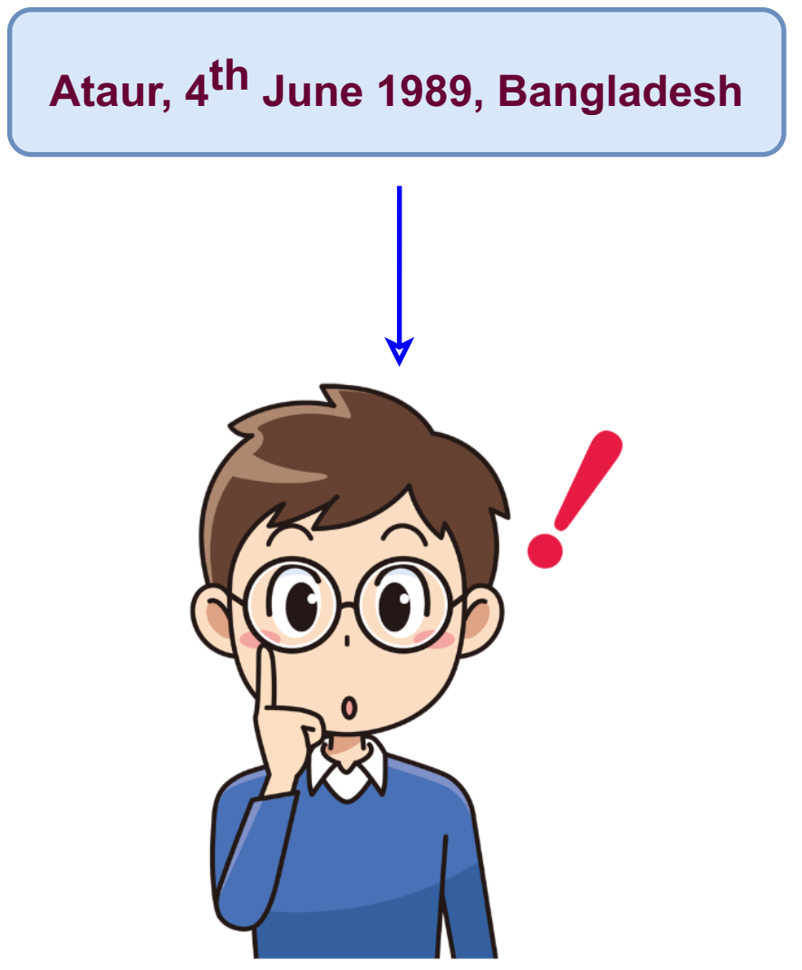
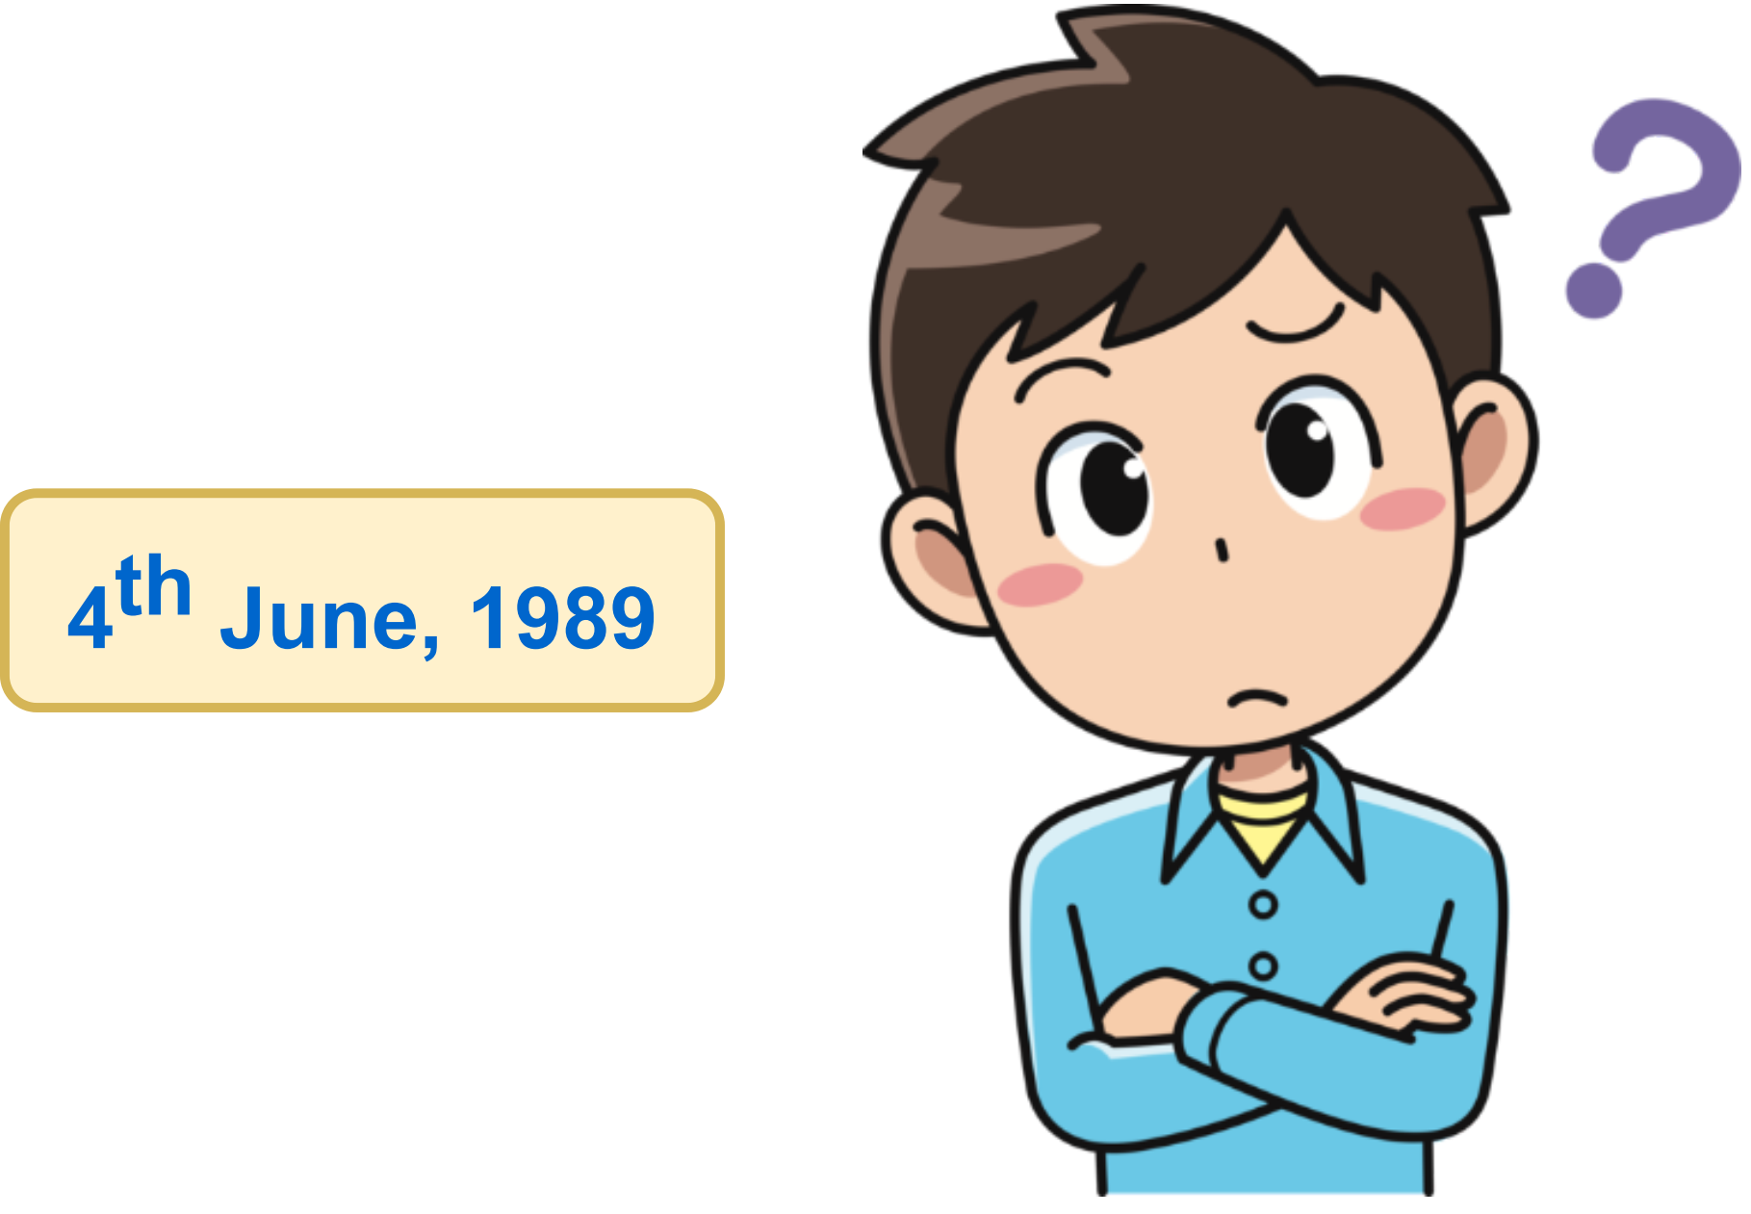
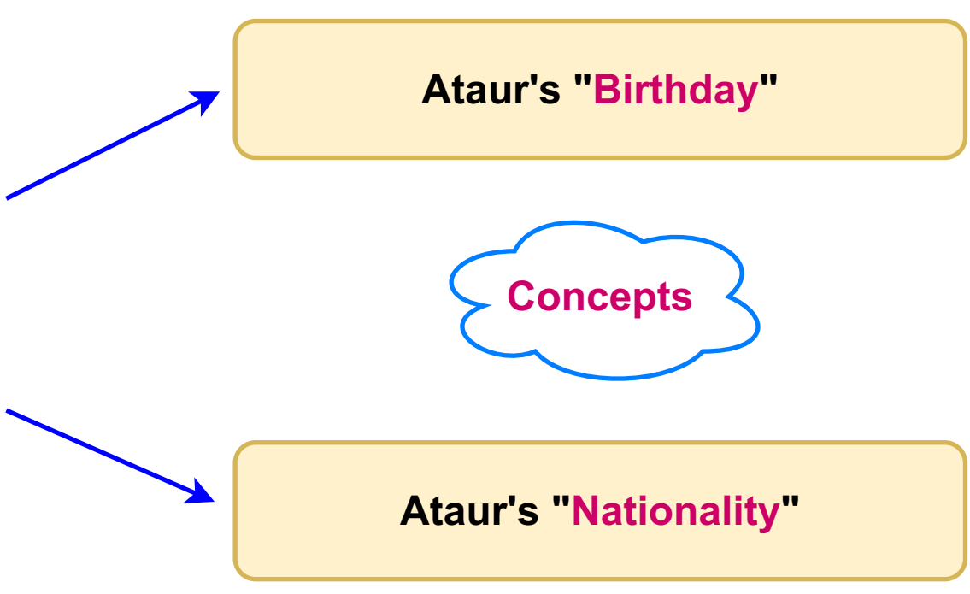
Motivation: Why Conceptualization?
Knowledge without Concepts.
Knowledge with Concepts.
Our aim is to map Textual instance into semantic Concept categories.
In the form of Knowledge Graphs (KG’s).
“Concepts are the glue that holds our mental world together”
̶ Gregory Murphy
Notes:
Imagine you are simply given with this Date.
Can anyone comprehend what’s the Significance of this Date? No! (Next)
Now let’s say you got some Context with the Date.
You can easily Conceptualize it (Right!!).
This Conceptualization will further enable us to do reasoning and inferences such as:
How the person might look like!
What could be his possible cultural or religious views.
And many more.
(Next)

Slide 6
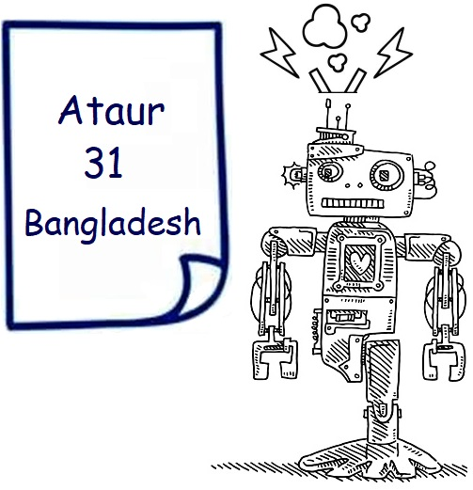
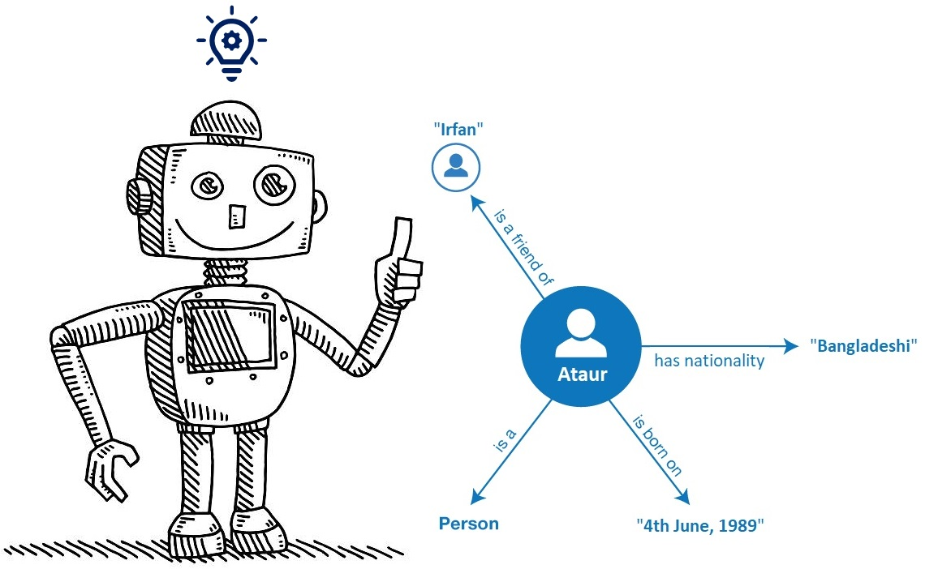
Motivation: Why Knowledge Graph?
Knowledge Graphs are self-descriptive.
They provide:
Context.
Explainability.
Efficiency.
Knowledge Graph facilitates Conceptualization.
“Words are for meaning. Once you get the meaning, you can forget the words.”
-- Zhuangzi
Notes:
So, Why we are motivated to use Knowledge Graphs? (Next)
Knowledge Graphs are Self Explanatory for both Humans and Machines. (next)
They provide Contextual Information.
Knowledge graph also offers Computational Efficiencies for:
querying stored data.
and Reasoning over them. (next)
And finally, Knowledge Graph facilitates Conceptualization.

Slide 7
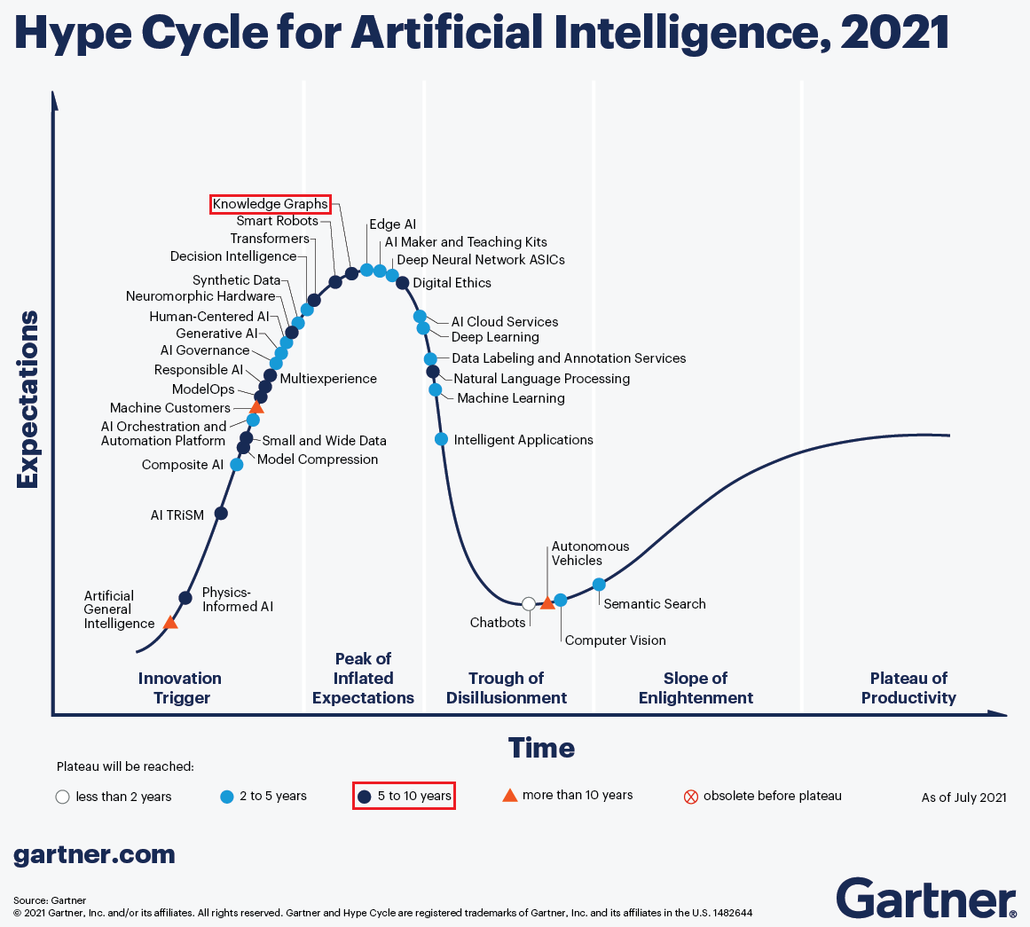
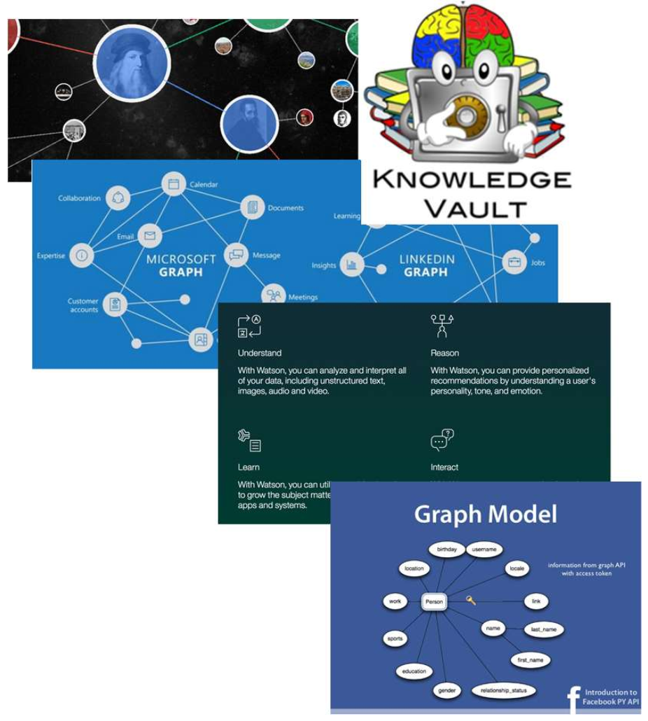
Knowledge Graphs and Industry
Google Knowledge Graph
Google Knowledge Vault
Amazon Product Graph
Facebook Graph API
IBM Watson
Microsoft’s
Probase
Satori
Project Hanover/Literome
LinkedIn Knowledge Graph
Yandex Object Answer
Diffbot, GraphIQ, Maana, ParseHub, Reactor Labs, SpazioDati
Notes:
These are the Companies who are using Knowledge Graphs. (NEXT)
And this was the Hype in 2021…
As you can see, Knowledge Graphs are still in the Peak of Inflated Expectations.
And we need to make them feasible and productive for general purpose usage.
https://www.gartner.com/en/articles/the-4-trends-that-prevail-on-the-gartner-hype-cycle-for-ai-2021

Slide 8
Preliminaries
Notes:
Let me discuss some Backgrounds before jumping to my Objectives (NEXT).

Slide 9
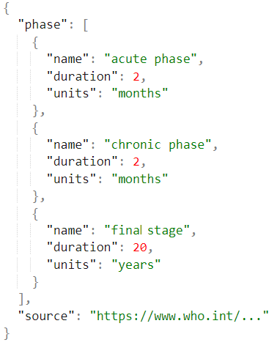

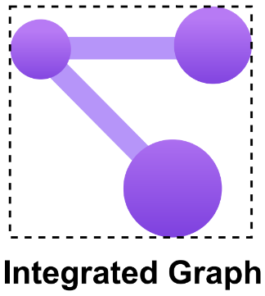
Example (Structured Data Integration)
JSON: Phase Information
CSV: Associated Risk
Phase | Risk Type | Affected Percentage (%)
acute | asymptomatic | 70 – 80
acute | symptomatic | 20 – 28
acute | sign of romagna | 2
chronic | cardiac disorders | 30
chronic | motor disorders | 10
DB Table: Disease_Has_Phase
Disease_Name | Phase_Name
Chagas | acute phase
Chagas | chronic phase
Chagas | final stage
Notes:
Before going into details, I will start by showing an Example of a typical Data Integration System.
Here are 3 small snippets of Structured Data Sources having information about Chagas Disease:
One is a Relational Database; another is a CSV file and the last one is a JSON file. (NEXT)
Data Integration involves Combining Data residing in different sources and providing users with a unified view of them.
And we already have a Data Integration System which Integrates these Structured Sources into an Integrated Graph (which is a Knowledge Graph of Concepts).
Let’s see how an Integrated Graph might look like.

Slide 10
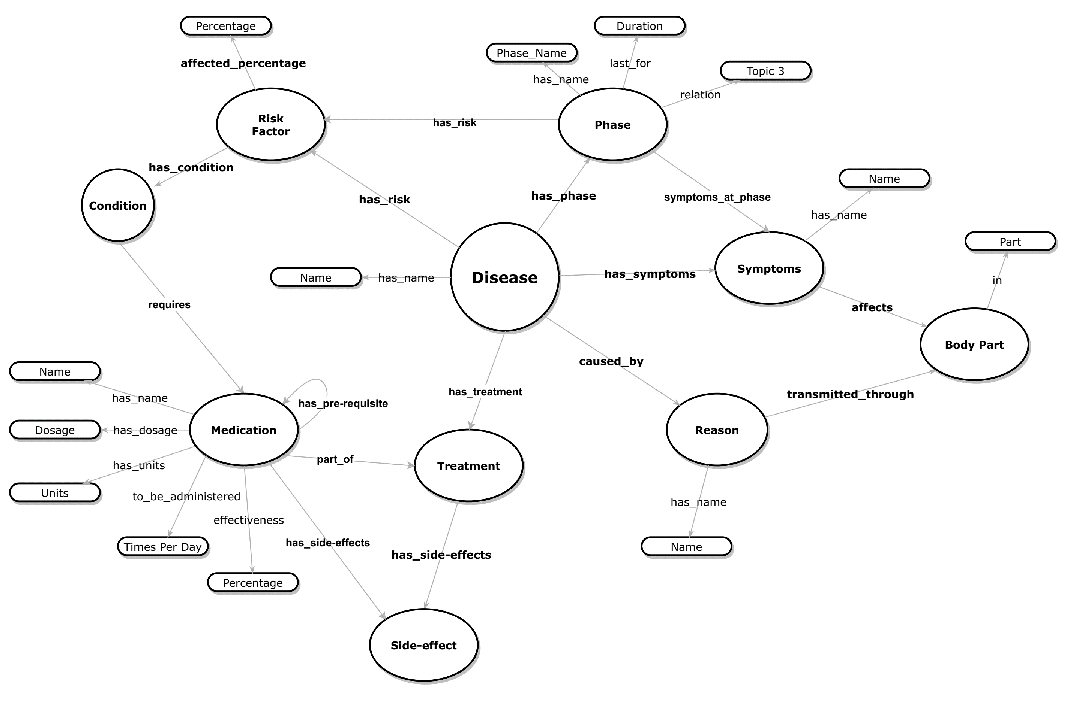
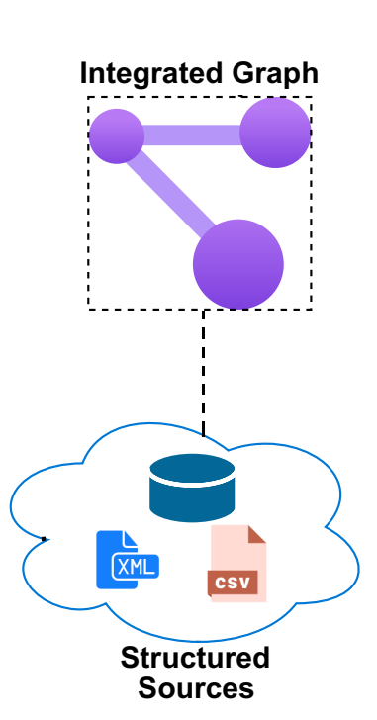
Running Example:
Integrated Graph for the Chagas Disease
A Knowledge Graph only having Concepts (Schema)
Notes:
Imagine we have an Integrated Graph connected with its Structured Sources. (next)
This Integrated Knowledge Graph will only contain Concepts (much like a schema) and NO actual instances.
Note from hereon, by concepts, I mean:
Entities, Relations and Attributes or Properties.
So here, Disease and Phase are examples of Entities.
Having Relationship - has_phase.
And Phase_Name might be an example of a particular Attribute.

Slide 11
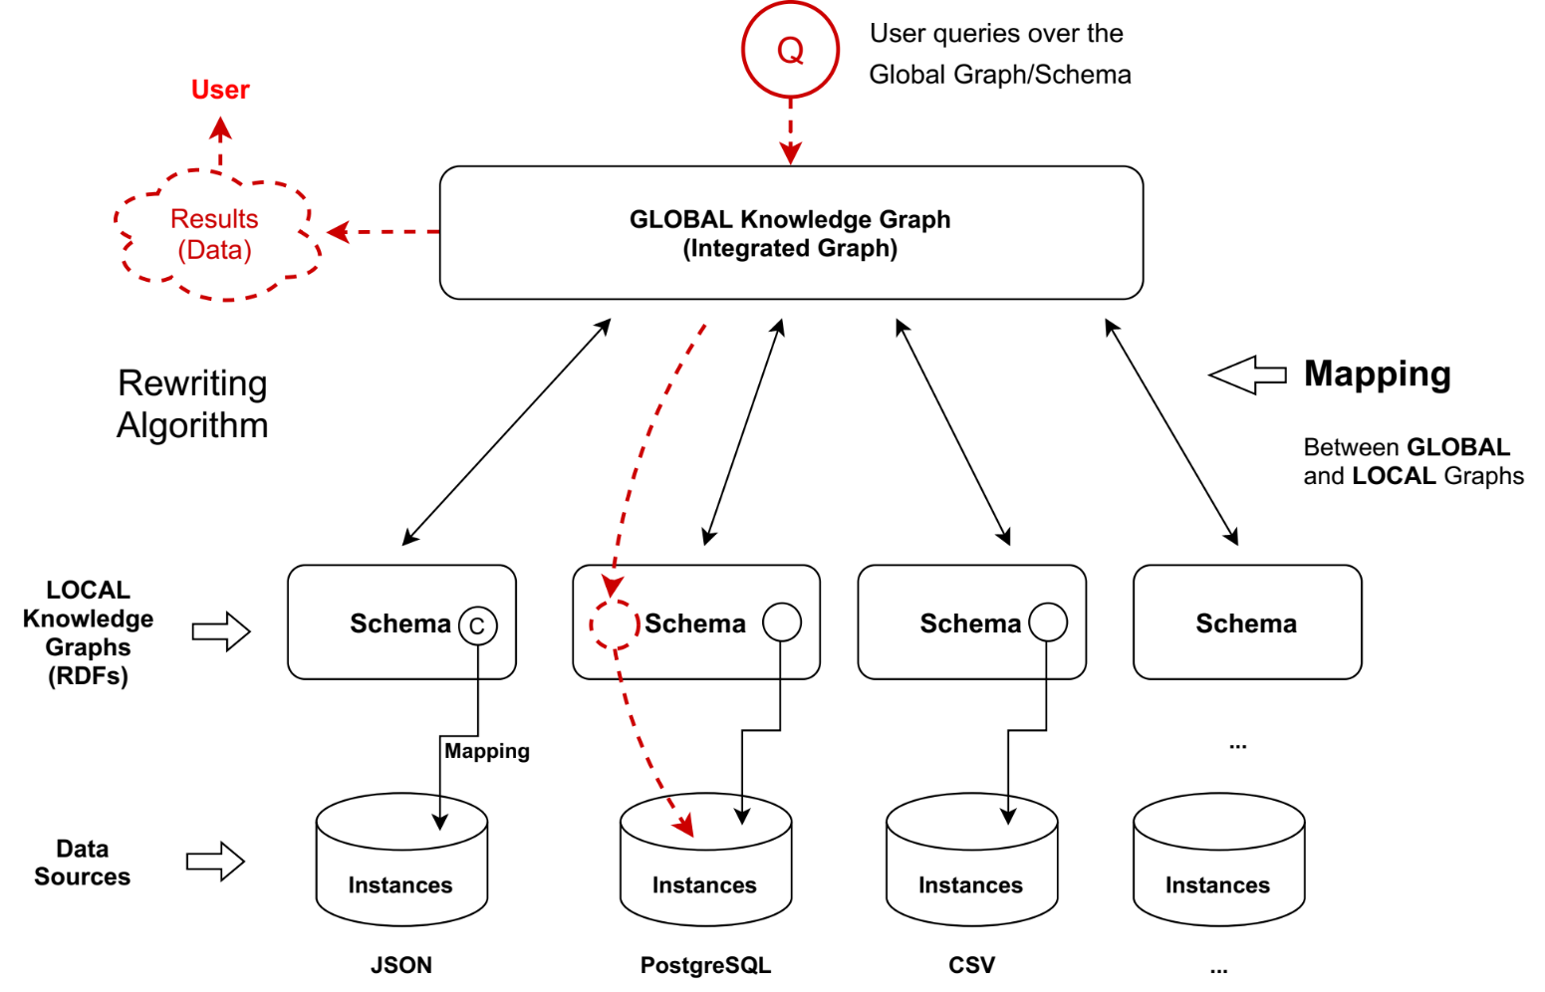
Existing Data Integration System
ODIN:
On-demand Data Integration [1]
Notes:
I am going to talk a bit about the existing Data Integration System that we have, before revealing my Objective. (next)
This is kind of an Abstract view of how the integration process works.
In the bottom part, we can see different structured sources.
And there are Local Graph which acts as individual Source Schema.
A Concept in the Source Schema is mapped to its corresponding instances through Wrappers.
There are also Mapping between Local and Global Graph, which is in our case the Integrated Graph we already talked about.
When a user queries over the Integrated Graph, a Rewriting Algorithm converts them to source specific queries and help pull the data from corresponding sources.

Slide 12
Objective
Notes:
Let me talk about our Objectives.

Slide 13

Objective
“Incorporate Textual Data in a
Graph-Based Data Integration System.”
Knowledge in Natural Language can easily remain hidden.
ODIN:
On-demand Data Integration [1]
Concept
Text
Source
Notes:
Integrating only structured Data is NOT often enough (NEXT).
Because there might be a vast amount of knowledge hidden in the Natural Languages such as Unstructured Texts which is important for decision making (NEXT)
Thus, the Main Objective of my Work is…
“To Incorporate Textual Data in this Graph Based Data Integration System.”
Be noted that, unlike most of the current works that are going on regarding text data integration, we are NOT interested about Instance-Level Integration.
We aim to do a concept-level data integration, so for that we need to map text instances into concepts first…
We will see why Integrating Text Source is not a Trivial Task throughout our presentation.

Slide 14
Sub-Objectives
“Incorporate Textual Data in a
Graph-Based Data Integration System.”
͏Bootstrapping conceptualized structures from text in the form of Knowledge Graphs.
͏Mapping the above structures with an existing Integrated Knowledge Graph.
Devising a new Rewriting Algorithm (RA) to query heterogeneous datasets (including textual data) via the Graph-based Data integration system.
Formulation of a Prototype that combines the best theory and approaches developed during the above stages.
Notes:
To achieve our Primary Objective, we have identified these 4 main Sub-Objectives.

Slide 15
Proposed Method

Slide 16
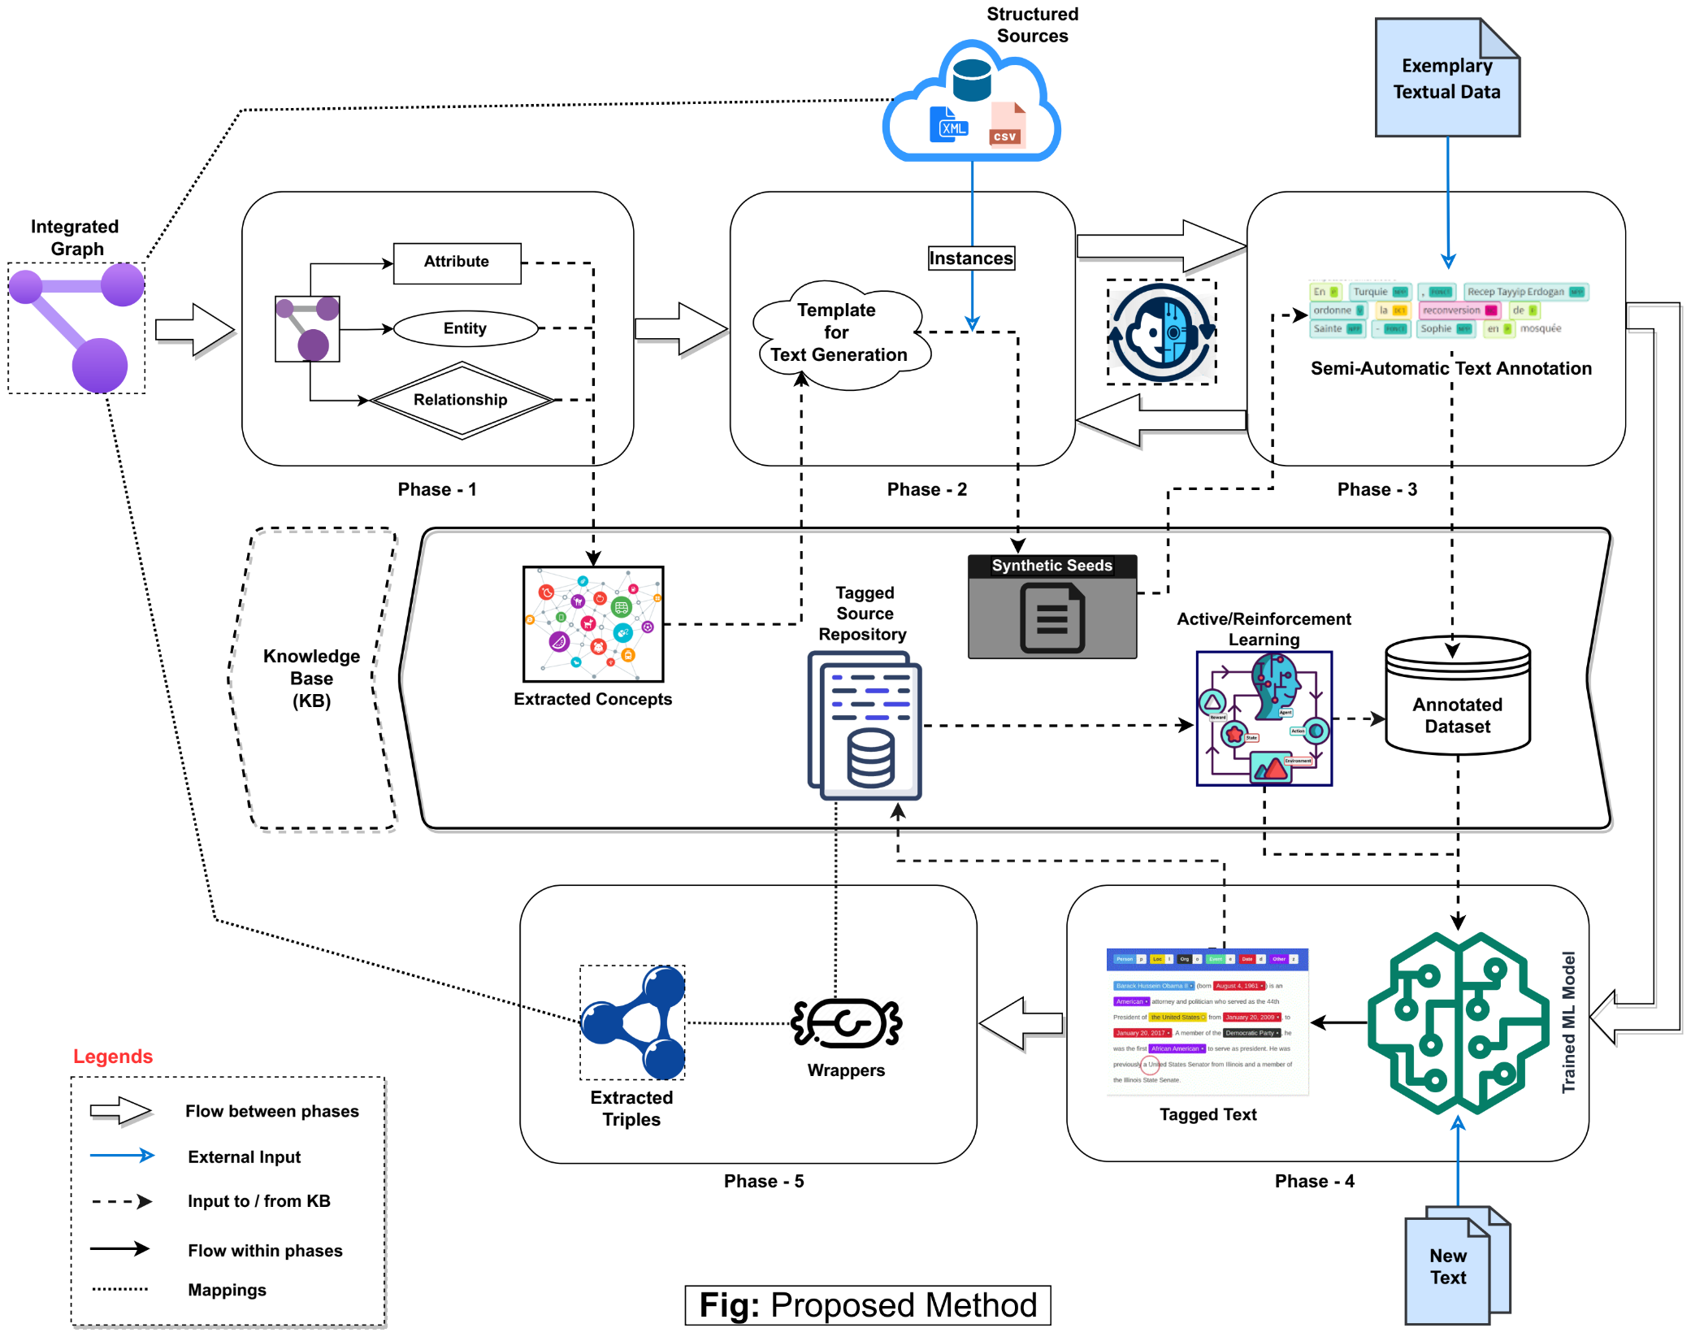
Proposed Method
Semi-Automatic Data Annotation
Knowledge Base
Training, Tagging
and
Mapping
Notes:
This is what we have envisioned for our Text Data Integration Pipeline.
I will explain each of this phases separately . . . but just to have an overall idea (next):
The top-most part mostly involves the:
Utilization of the Concepts Extracted from the IG, and the Instances from the Structured Sources.
in order to Semi-Automatically Annotate an exemplary Text Dataset.
So that we can use that Dataset to Train or Fine-Tune a Machine Learning Model in the later phases.
The middle part is where we will be storing our intermediated results during different Phases in the form of a Knowledge Base.
And the phases in bottom part will focus on:
Training some form of ML model (such s a Language Model) for Tagging completely New Text Sources with Concepts.
And also, to Map those Tagged Texts with the associated Concepts in the Integrated Graph.
So, in a nutshell – we are using the Structured Data to Annotate the Exemplary Textual data which in turn will
act as the Training Data for learning a model in order to Tag New Unseen Text based on these knowledge.
Thus, as a whole facilitating Unstructured Data Integration.

Slide 17
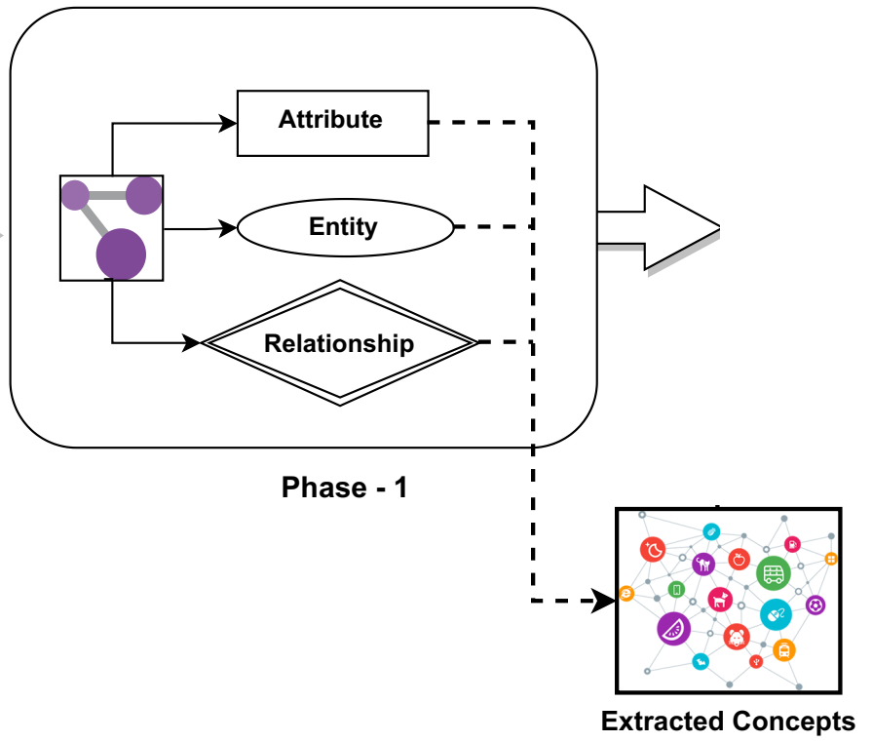
Phase-1
Extract Concepts (Entities/Relations/Attributes) from Already Existing Sources using the Integrated Graph:
Identify the existing Entities and Relations relevant for extracting information from the textual data.
Extract Attributes in combination with the Entities and Relations.
Input: Integrated Graph (IG) Output: Concepts (Entities/Relations/Attributes)
Challenges:
Isolated Entities/Relationships or combinations?
Combinations might be exhaustive depending on the size of IG.
Meaningful combination.
Notes:
So here is the First Phase where we want to simply…
Extract Concepts from the Integrated Graph.
It involves Identifying existing Entities, Relations and Attributes in the graph.
The challenges are:
Either to treat them in Isolation.
Or to combine them in some meaningful way (such as triples or n-ary relations).

Slide 18
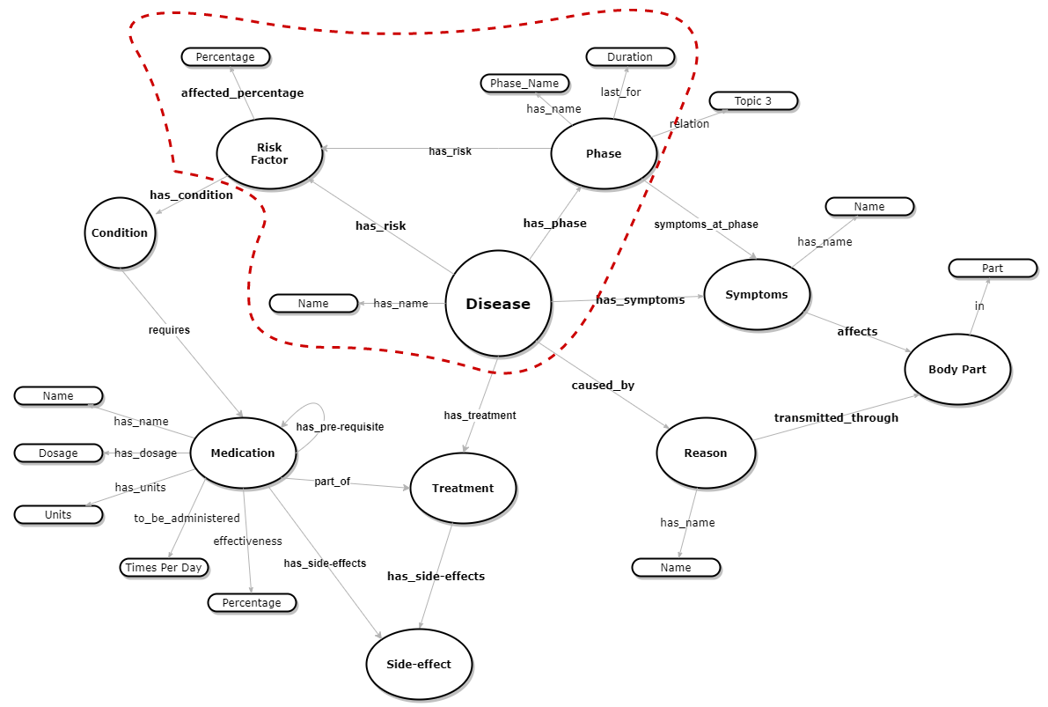
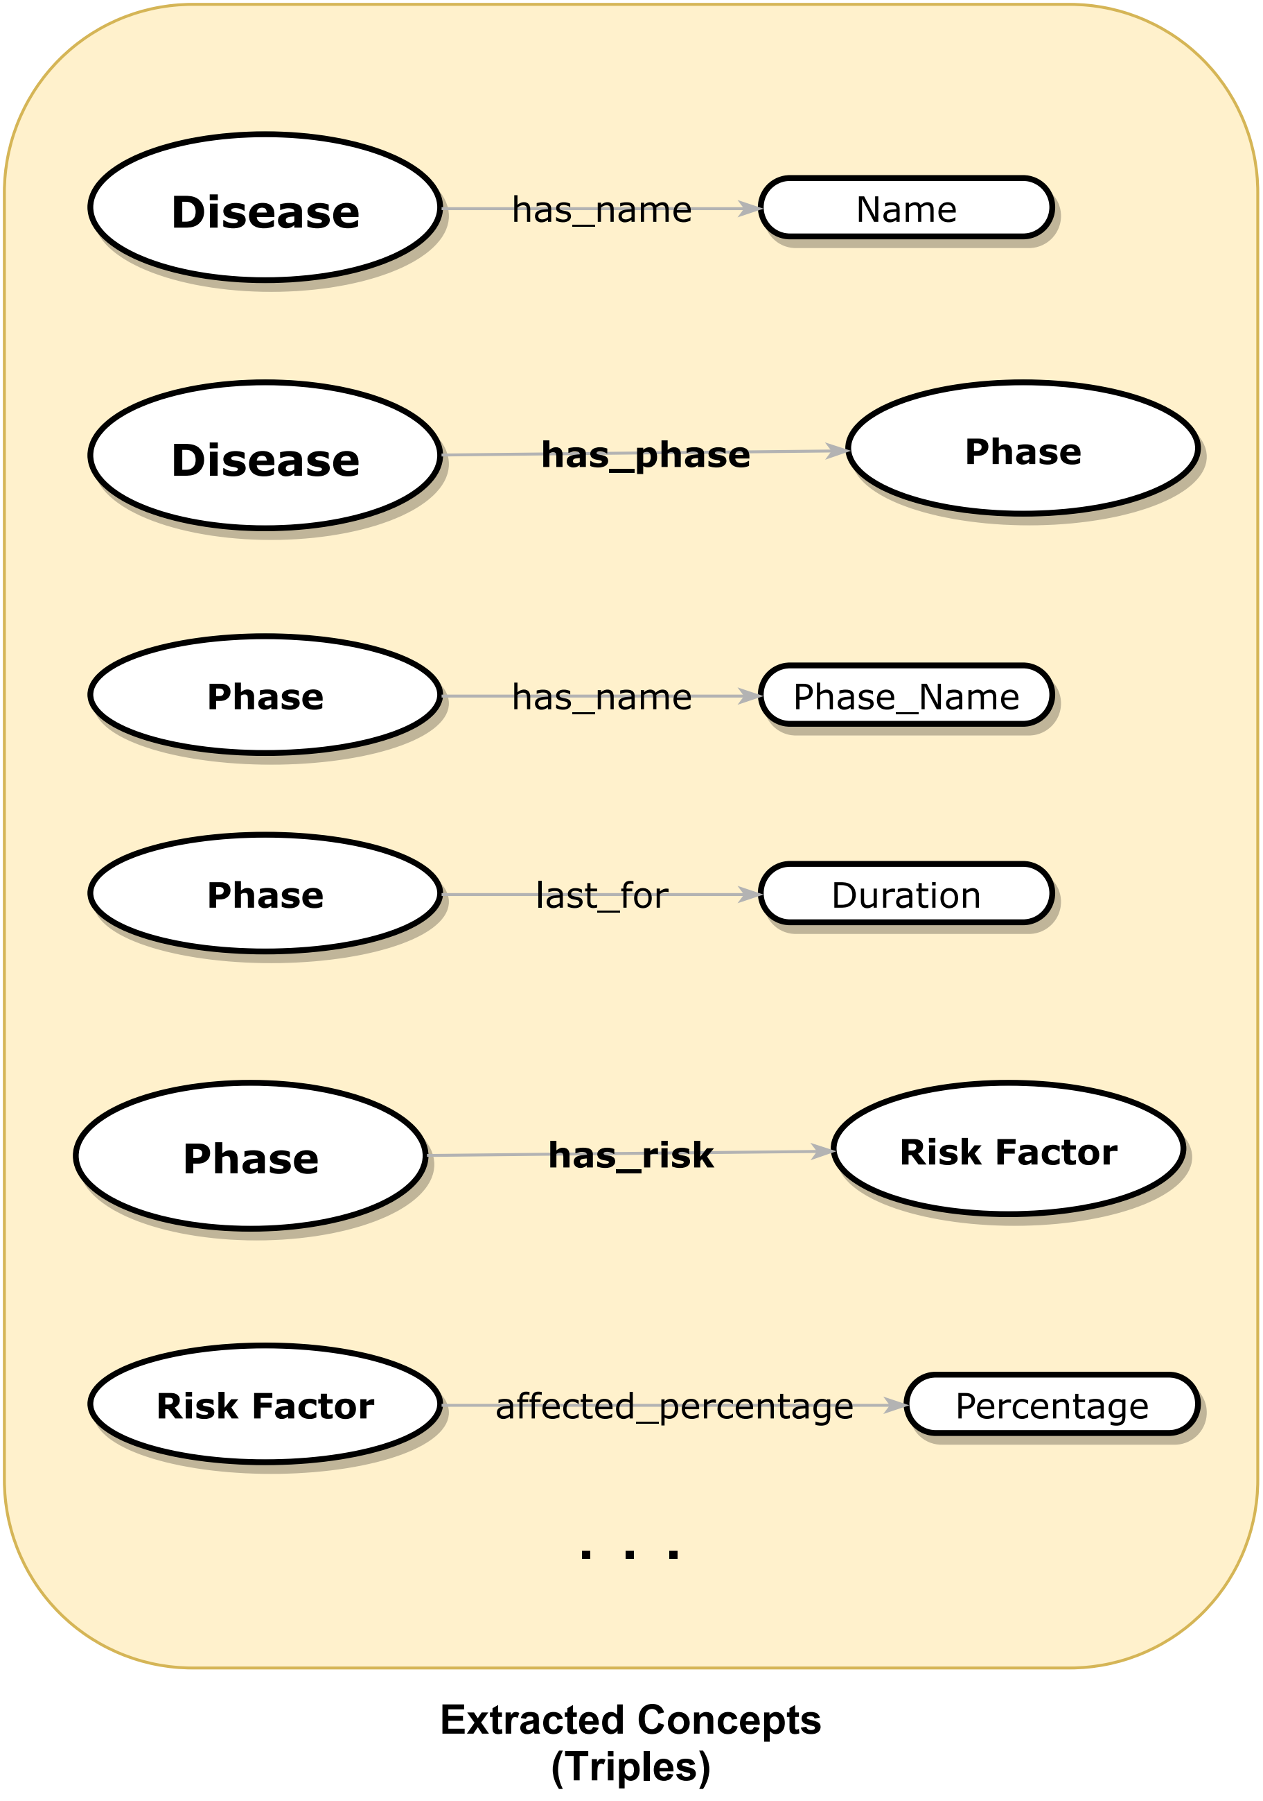
Running Example (Phase-1: Extract Concepts)
Notes:
Lets, continue with our running example.
A simple approach might be to just consider all possible Triples from the Integrated Graph in this Phase.

Slide 19
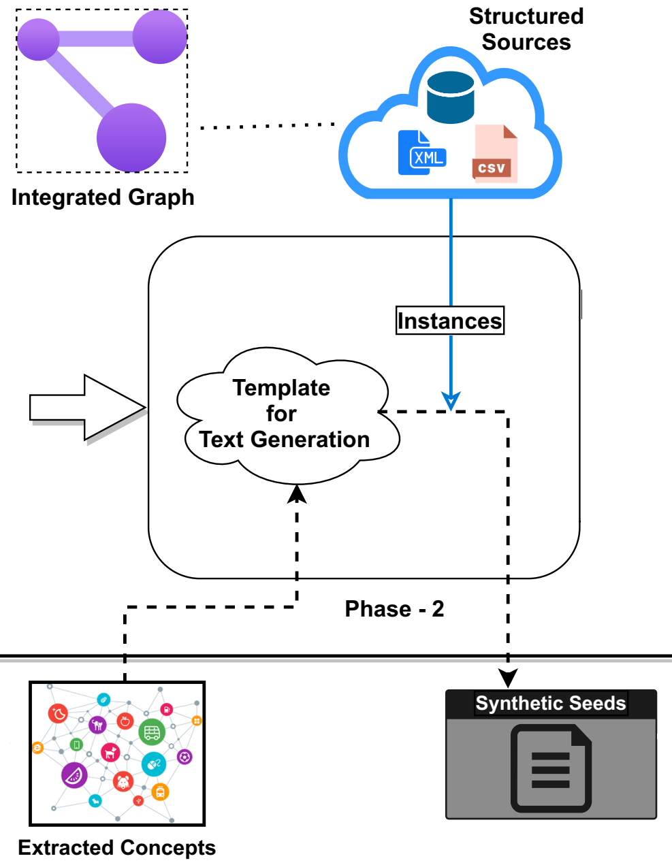
Phase-2
Produce Templates from the extracted Concepts and generate Synthetic Seeds by populating the templates with Instances from the Structured Data Sources:
Construct the Templates to generate synthetic text from the extracted concepts.
Find other Structured Data Sources that may provide Instances for those concepts.
Using the Instances in the Templates having Concepts, generate all probable Synthetic Seeds in the form of Descriptive Semi-Structured Texts.
Input: Concepts + Instances of Structured Sources Output: Synthetic Seeds
Notes:
The next phase is to:
Use the concepts to form all plausible Templates or Rules.
Instantiate those Templates using the Structured Data Sources.
And finally get some Semi-Structured Texts which we termed as Synthetic Seeds.

Slide 20
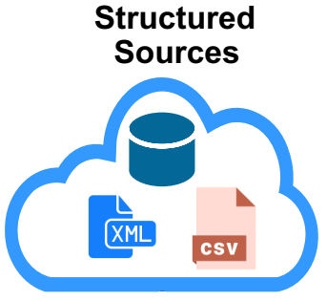
Running Example (Phase-2: Produce Templates & Synthetic Seeds)
Synthetic Seeds
Templates
Disease_E has_d_name_RA <Chagas>
Disease_E has_d_name_RA <Chagas> has_phase_RE Phase_E
Disease_E has_d_name_RA <Chagas> has_phase_RE Phase_E has_p_name_RA
<acute phase>
. . .
Disease_E has_d_name_RA <Name_X>
[ Disease_E has_d_name_RA <Name_X> ] has_phase_RE Phase_E [[ Disease_E has_d_name_RA <Name_X> ] has_phase_RE Phase_E ] has_p_name_RA <Phase_Name_Y>
. . .
Notes:
So, during this Phase, the Templates might look like this.
Here I have color-coded different concept categories, for Example:
Green ones represent Entities such as Disease, Phase etc.
The Red colors are for Relations between two Entities.
While the Yellow ones are Relation between Entities and Attributes.
Whereas the Attributes are in White having a Placeholder for the Instances to fill them with.
Next, we will try to fill the Placeholders in the Templates with the Instances from the Structured Sources.
This in turn will produce the Synthetic Seeds.
Note that, we want the Synthetic seed to act as a catalyst for the next phase where we want to semi-automatically Annotate some real texts.
Thus, we most probably need to re-phrase the Synthetic Seeds into something that is at least Coherent and can act like Semi-structured texts instead of this simplified assumption.
This is indeed one of the big challenges during the first 3 phases.

Slide 21
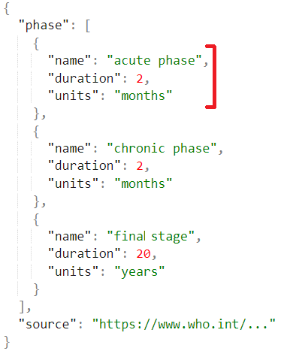
Running Example (Cont.)
JSON: Phase Information
Risk_Associated.csv
Phase | Risk Type | Affected Percentage (%)
acute | asymptomatic | 70 – 80
acute | symptomatic | 20 – 28
acute | sign of romagna | 2
chronic | cardiac disorders | 30
chronic | motor disorders | 10
DB Table: Disease_Has_Phase
Disease_Name | Phase_Name
Chagas | acute phase
Chagas | chronic phase
Chagas | final stage
Templates
Synthetic Seeds
Disease_E has_d_name_RA <Chagas> has_phase_RE Phase_E has_p_name_RA <acute phase> last_for_RA <2> have_units_RA <months> has_risk_RE Risk_Factor_E of_type_RA <symptomatic> affected_percentage_RA <20 – 28 %>
Notes:
Consider these Sample Structured Data Sources that I showed previously. (NEXT)
Let’s see how we can use the Instances from these Sources to Populate a Template.
This is an extended template in which we instantiate the:
Disease name and the Phase Name from the Relational Database.
The Duration of the Phase as well as the Units from the JSON file.
And the Attributes of Risk Factor entity is populated from the CSV file.

Slide 22
Phase-2
Produce Templates from the extracted Concepts and generate Semi-Structured Text by populating the templates with Instances from the Structured Data Sources:
Challenges:
Combining (arrangement) different attributes of the entities with the corresponding relations to form templates that produces:
Coherent seeds that is at least semantically sound.
Constructing minimal set of Templates from exhaustive combinations of entity-relations-attributes.
Retrieving the Instances from the other data sources – based on the Concepts in the templates that:
Considers contextual information withing the same template.
Generating all plausible cases of seeds based on the instances.
Disease_E has_d_name_RA <Chagas> has_phase_RE Phase_E has_p_name_RA <chronic phase> last_for_RA <20> have_units_RA <years> has_risk_RE Risk_Factor_E of_type_RA <motor disorders> affected_percentage_RA <10%>
Notes:
These are the challenges for this Phase (shown in the slides).
Combining and forming coherent and semantically sound Templates are the biggest challenge because.
All possible combination might be exhaustive and not useful (NEXT).
All the instances for a given concept might not even be plausible for a given template. So, we need to also consider the context.
(NEXT) So, this is another plausible case have the same template as before but instantiated with different values.
And there could be many more challenges…

Slide 23
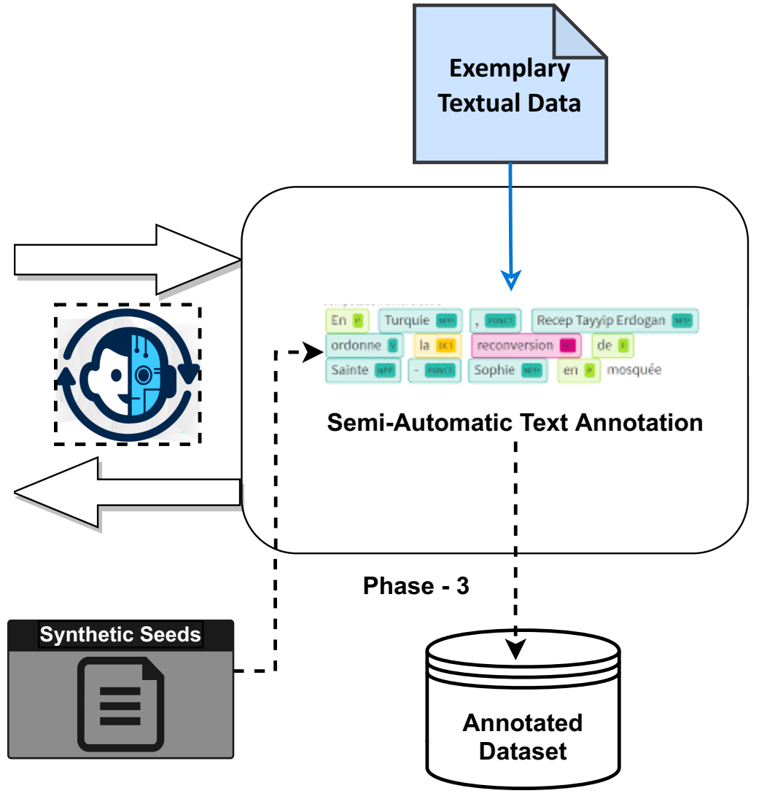
Phase-3
Semi-Automatically Annotate New Exemplary Text with Concepts as Tags:
Using the synthetic seeds, semi-automatically annotate a real text dataset having entities, relations and attributes as Tags.
Weak/Distance Supervision [2][13].
Keeping Human In the Loop.
Consider NLP techniques such as:
Universal Dependencies / Syntactic Parsing.
Semantic Similarity.
Entity Recognition, Linking, Resolution and Disambiguation.
Coreference Resolution.
Input: Synthetic Seeds Output: Annotated Dataset
Notes:
[NEXT] Phase-3 consists of semi-automatically Annotating a real-world Text Dataset using which we will be able to Train our Model later on [NEXT].
This is necessary because, the Synthetic Seeds are kind of artificial and are NOT representative of the real-world Texts.
During this phase, we have to rely heavily on Natural Language Processing and Information Extraction techniques.

Slide 24
Running Example (Phase-3: Semi-Automatic Annotation)
Chagas disease has two clinical forms: an acute phase and a chronic phase. In most initial cases,
(70-80% of the infected) symptoms are absent and have mild risk, while a 20-30% of the ones infected evolve into the chronic phase, which includes symptoms that indicate damages to the tissue of the heart, digestive system and/ or nerves system.
Annotation
[Disease_E][has_d_name_RA] Chagas [/has_d_name_RA] disease [/Disease_E] [has_phase_RE] has two clinical forms [/has_phase_RE]: an [Phase_E][[has_p_name_RA] acute phase [/has_p_name_RA] and a [has_p_name_RA] chronic phase [/has_p_name_RA][/Phase_E].
In most [has_p_name_RA] initial cases [/has_p_name_RA], ([Risk_Factor_E] [affected_percentage_RA] 70-80% [/affected_percentage_RA] of the infected [/Risk_Factor_E]) [of_type_RA] symptoms are absent [/of_type_RA] and [has_risk_RE] have mild risk [/has_risk_RE]
. . .
Text Source: https://www3.paho.org/...
Notes:
Here is a snippet of a real-world text (NEXT).
After this Phase, we would expect to have Annotated the Text with the Concept Tags, that might look somewhat like this.
Again, this is just to exemplify the idea. The real implementation might be something different.
It might also be a good idea to store these Concept – Instance pairs for further use.

Slide 25
Phase-3
Semi-Automatically Annotate New Exemplary Text with Concepts as Tags:
Challenges:
Measuring the semantic similarities between the real text data and the synthetic seed’s placeholder.
forms ↔ phases; initial cases ↔ acute phase
Resolving the synonyms or variations of instances denoting the same concepts.
Correctly placing the entity/relation tags can be difficult in many cases.
[Risk_Factor_E]
Ordering of concepts within the text.
Relations can appear before or after an entity/attribute name:
… around [E][A]70-80%[/A][/E] of the infected people, in most [E][A]initial cases[/A][/E] symptoms are absent and [/R]have mild risk[/R]…
Notes:
These are some of the Challenges in this Phase among many…

Slide 26
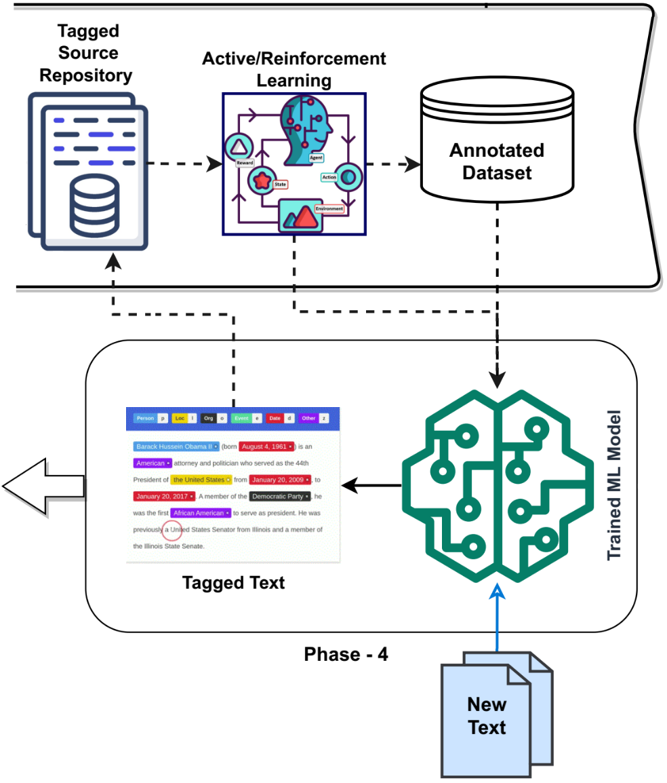
Phase-4
Train an ML Model using the annotated data for Tagging New Text with Concepts:
Train some form of ML models (e.g., language model) using the annotated dataset.
Tag new text with concepts that will align with our existing concepts (possibly also extend).
Save the tagged text sources in a repository.
Improve the dataset and the model using the tagged texts.
Input: Annotated Dataset + ML Model + New Text Output: Tagged Text
Notes:
In this phase, we would like to Train a Machine Learning Model with the Annotated Data from the previous Phase.
State-of-the-art works mostly uses Pretrained Language models such as BERT variants
and fine-tune them with domain specific dataset.
We plan to use our small Annotated dataset for this purpose.
And finally, we want to use that model to Tag Completely New Texts with Concepts.

Slide 27
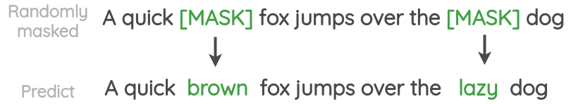
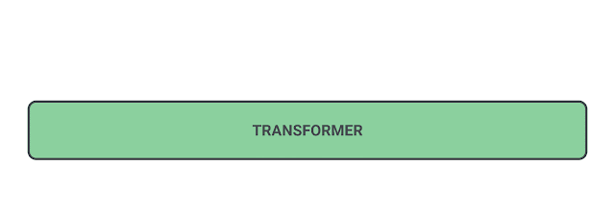
Example (Masked Language Modeling)
Word Prediction
Phrase/Sentence Prediction
Image Source: https://ai.googleblog.com/2020/06/pegasus-state-of-art-model-for.html
Notes:
This is a typical example of Masked Word Prediction using a Language Model.
Given a Word the model would predict the Next or Previous Word (NEXT).
And it is also possible to extend this into Phrases or even Sentence-Level Prediction Task.

Slide 28
Running Example (Phase-4: Tagging New Text)
New Text
After the infection of [ ? ] American Trypanosomiasis [ ? ] is transmitted, [ ? ] there is [ ? ] an initial, [ ? ] acute phase [ ? ] that [ ? ] lasts for [ ? ] about [ ? ] two months [ ? ] . During the chronic phase that succeeds the acute phase, up to 30% of patients suffer from cardiac disorders…
After Tagging
After the infection of [Disease_E][has_d_name_RA] American Trypanosomiasis [/has_d_RA] [/Disease_E] is transmitted, [has_phase_RE] there is [has_phase_RE] an initial, [Phase_E][has_p_name_RA] acute phase [/has_p_name_RA][Phase_E] that [last_for_RA] lasts for [/last_for_RA] about [Duration_A] two months [/Duration_A] . . .
Text Source: https://www.who.int/health-topics/chagas-disease#tab=tab_2
Notes:
So, following the similar principle
After the training is done, we might expect our Language Model to see the New Texts like this (NEXT).
So, instead of Next or Previous Words, our model would predict the Concept Tags.

Slide 29
Phase-4
Train an ML Model using the annotated data for Tagging New Text with Concepts:
Challenges:
(Semi-)Automatically generating enough training data for the model to work on.
Noise in the automatically generated training data (Data Quality).
Extending the concepts (new) apart from only finding the existing one.
Evaluation of the model’s output.
Notes:
And there could be many more challenges…

Slide 30
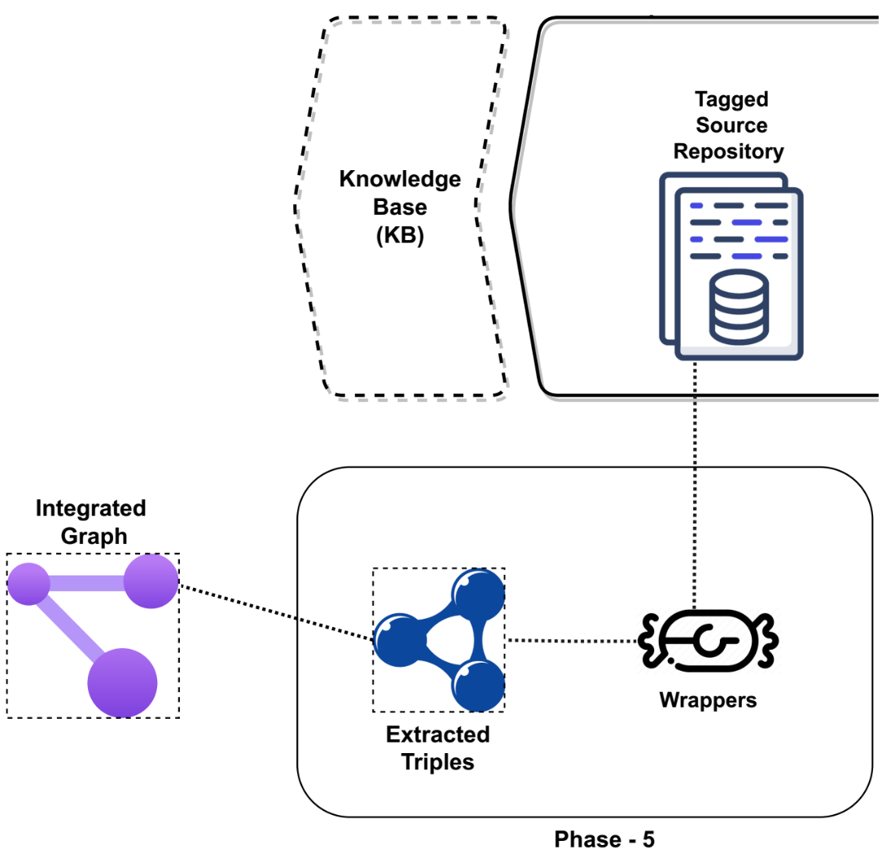
Phase-5
Mapping the Instances of Tagged Text with the Concepts in the Integrated Graph:
Generate a Structured Representation (e.g., triples).
Create wrappers using which triples can be linked to its corresponding instances within the text.
Map those triples with the Concepts in the Integrated Graph (IG).
Input: Tagged Text Source Output: Instances Mapped to IG

Slide 31
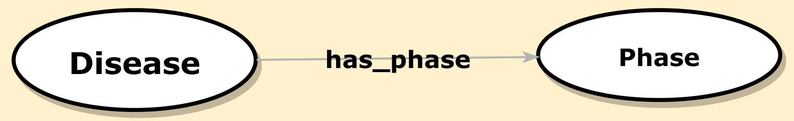
Running Example (Phase-5: Mapping)
Tagged Text Source
After the infection of [Disease_E][has_d_name_RA] American Trypanosomiasis [/has_d_RA] [/Disease_E] is transmitted, [has_phase_RE] there is [has_phase_RE] an initial, [Phase_E][has_p_name_RA] acute phase [/has_p_name_RA][Phase_E] that [last_for_RA] lasts for [/last_for_RA] about [Duration_A] two months [/Duration_A] . . .
Wrappers
(American Trypanosomiasis, has_phase, acute phase)
Triples
Mapping
Concepts (IG)
Notes:
Note that, since our goal from the beginning was to keep the Source As It Is.
We have to Map those Contiguous Text Instances with the Concepts from the Integrated Graph.

Slide 32
Phase -5
Mapping the Instances of Tagged Text with the Concepts in the Integrated Graph:
Challenges:
Tracing back to the correct combinations of concepts (triples, quadruple, …) from continuous tagged text.
Relations between entity/attribute pairs or relations as a separate element?
Entity/Attribute extraction → Relation extraction.
Entity + Relations (concurrent).
Making the representation compatible with the existing Integrated Graph.
Getting higher level concepts by combining existing concepts.
Medication isA Treatment
Student + Teacher = Person
Notes:
And there could be many more challenges…

Slide 33
Phases
Extract Concepts (Entities/Relations/Attributes) from Already Existing Sources using the Integrated Graph (IG).
Produce Templates from the extracted Concepts and generate Synthetic Seeds by populating the templates with Instances from the Structured Data Sources.
Semi-Automatically Annotate New Exemplary Text with Concepts as Tags.
Train an ML Model using the annotated data for Tagging New Text with Concepts.
Mapping the Instances of Tagged Text with the Concepts in the Integrated Graph.

Slide 34
Related Work

Slide 35
Related Work
Ontology Learning
Knowledge Graphs
Concept Extraction
Synthetic Data Generation
Querying KGs in NL
Data Integration
Text
No Silver Bullet
We have to combine things from several sub-domains of NLP, KG, Data Integration and so on.
One Size Doesn’t Fit All
Again, our task is somewhat different from what people from each of these domains been working on.
Notes:
These are the associated domains that somehow relates to Text Data integration and Overlaps with the Task that we envisioned.
I am going to quickly go through some of them next.

Slide 36
Related Work
Domain | Task | Approaches | References (et al.)
Data Integration | Modeling based on: Virtual or mediator Physical Schema Extraction Local graph construction Mapping Each dataset to the graph Schema Mapping Entity disambiguation Node matching (Schema Matching) Integrated/Global graph construction Schema Builder | Mapping: Global-As-View (GAV) Local-As-View (LAV) Global-Local-As-View (GLAV) Both As View (BAV) Hypergraph Model (HDM) Wrappers Linguistic meta-modeling syntactic rules Logical Formalization (FOL) Schema Translation E.g., Source-S to RDFS Instance value matching. | Williams (2003) [22] Buitelaar (2008) [23] Alqarni (2012) [24] Augenstein (2012) [25] Golshan (2017) [26] Tadesse (2019) [28] Nadal (2021) [29] Jovanovic (2021) [30] Anadiotis (2022) [31]
Notes:
These are the process that involves Data Integration in general.
For text data integration, current literature mostly uses the techniques that I will mention in the following 2 slides.
As I mentioned, I haven’t found any work that uses concept-level text integration.
Data Integration –
BAV provides a richer integration framework than is provided by GAV, LAV, and GLAV approaches.
In particular, it is capable of providing a complete mapping between schemas in both directions, and hence is of particular relevance to P2P applications and Web Services.
HDM - Hypergraph-based Data Model

Slide 37
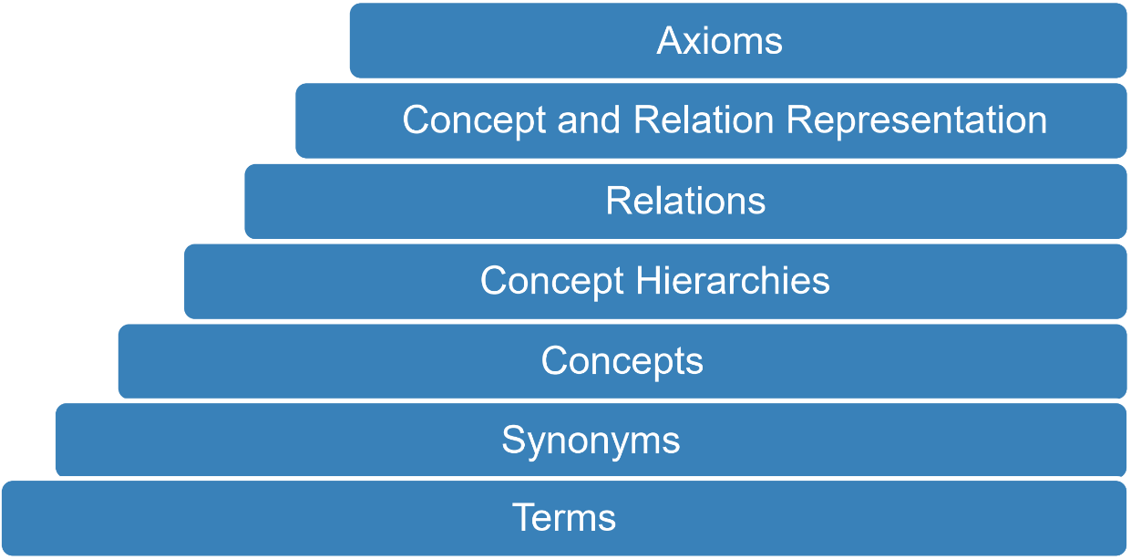
Related Work
Domain | Approaches | References (et al.)
Ontology Learning (from Text) | Pattern-based extraction POS tagging, Sentence parsing Syntactic/Dependency Structure Analysis Co-occurrence Analysis Association Rules (using seed KB) Heuristic and Conceptual Clustering Ontology pruning | Maedche (2000) [5] Shamsfard (2004) [6] Buitelaar (2005) [7] Gómez-Pérez (2005) [8] Alobaidi (2018) [9] Gómez-Suta (2020) [10] Khadir (2021) [11]
Fig: Layer Cake of Outputs for Ontology Learning
Notes:
Ontology Learning–
Term Extraction - A term is multi-word or single-word token (Instance), which denotes a specific meaning in a given domain.
Synonym Discovery - aims to find the terms that indicate the same concept. People uses WordNet for this mostly.
Concept Formation – forming concepts from text instances.
Concept Hierarchy - This task aims to build the hierarchical taxonomy of concepts by inducing, extending and refining the concepts.
Relation Discovery - aims to extract a novel relationship between known concepts.
Rule or Axiom Extraction - is the final sub-task in the OL process. It aims to infer the rules based on extracted concepts and relations
Approaches –
Ontology pruning - It is used to build a domain relevant ontology by using heterogeneous sources

Slide 38
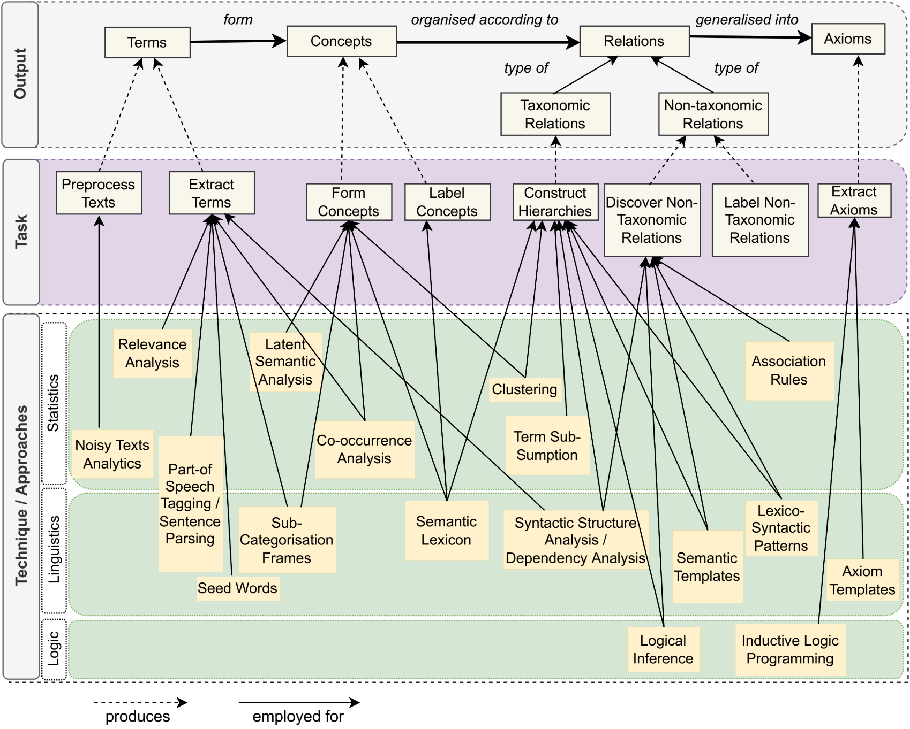
Related Work (Ontology Learning)
Fig: Classical Approaches, Tasks and related Outputs for Ontology Learning

Slide 39
Related Work
Domain | Task | Approaches | References (et al.)
Concept Extraction (Entity, Relation, Attribute) | Non-/Taxonomic Relation Extraction Named Entity Recognition Automatic Triples Extraction Concept Linking Semantic Similarity Coreference Resolution | Lexico-syntactic patterns Semantic templates Universal Dependency parsing (Semantic). Domain specific verb patters. Syntactic (PSG) parsing. Unsupervised relation extraction templates | Liu (2008) [12] Mintz (2009) [13] Nakashole (2011) [14] Yahya (2014) [15] Gillani (2015) [16] Madaan (2016) [17] El-Kilany (2017) [18] Kaushik (2018) [19] Qiu (2018) [20] Al-Aswadi (2020) [21] Maedche (2020) [10]
Notes:
Concept Extraction –

Slide 40
Related Work
Domain | Task | Approaches | References (et al.)
Knowledge Graph From Text | Resolve Co-References Classify Entities (NER) Extract Relations Predicate Mapping Triples (RDF) Extraction, Integration and Enrichment Linking to target Knowledgebase Ingest into target Knowledge Graph Property Selection Representation triple, n-ary | Rule-based candidate generation Similarity-based mapping Thematic Roles for relation phrase association. Semantic Role Labeling. Distance Supervision. Discourse based relation extraction Semantic Frame Parsing OpenIE-Based methods. NP association | Natthawut (2018) [32] Jay (2018) [33] Jose L. (2018) [34] Ryan (2019) [35] Jiayuan (2019) [36] Meng (2020) [37]
Notes:
Knowledge Graph from Text–
Thematic Roles - any of a set of semantic roles that a noun phrase may have in relation to a verb, for example agent, patient, location, source, or goal.

Slide 41
Tools
Data Integration | Ontology Learning | Knowledge Graph (From Text) | Concept (Entity / Relation) Extraction
ConnectionLens SIRE LODifier AutoMed ESTEST | ASIUM CRCTOL DODDLE-II HASTI OntoCmaps SYNDIKATE TEXT2ONTO TEXT-TO-ONTO TextStorm PROMINE GATE LexO OntoGain OntoLearn | Expert.AI Neo4j TextDistil T2KG FRED DeepDive NELL ReVerb Wikidata* PATTY* | Snorkel Text-Runner AmbiverseNLU Apache UIMA Ontotext Microsoft Concept Graph OntoGain FRED PIKES YAGO2*

Slide 42
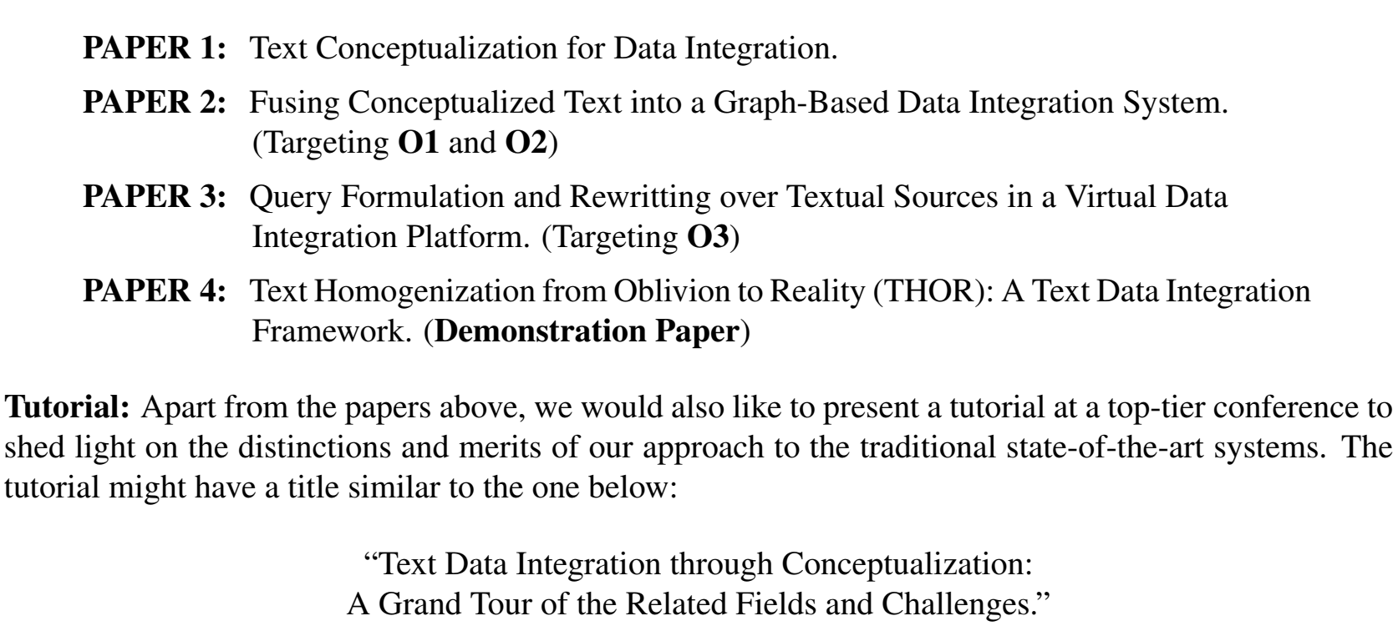
Tentative Publication
Notes:
These are the Probable Papers Targeting the Objectives and Milestones during my PhD program.

Slide 43




Conclusion
Our aim is to integrate unstructured text source with a graph-based data integration system,
keeping the source intact.
Assuming the graph-based integration system already contains integrated structured sources.
We aim to extract concepts from text and map them with the concepts in the Integrated KG.
Unlike most of the previous works where they use only the text instances to construct the knowledge graph, our main novelty comes from –
“Conceptualization of Textual Knowledge”

Slide 44
References
[1] | Nadal Francesch, S., Rabbani, K., Romero Moral, Ó., & Nigatu, S. T. (2019). ODIN: A dataspace management system. In Proceedings of the ISWC 2019 Satellite Tracks (Posters & Demonstrations, Industry, and Outrageous Ideas): co-located with 18th International Semantic Web Conference (ISWC 2019): Auckland, New Zealand, October 26-30, 2019 (pp. 185-188). CEUR-WS. org.
[2] | Agarwal, Oshin, et al. "Knowledge graph based synthetic corpus generation for knowledge-enhanced language model pre-training." arXiv preprint arXiv:2010.12688 (2020).
[3] | Zhongyuan Wang and Haixun Wang, Understanding Short Texts, in the Association for Computational Linguistics (ACL) (Tutorial), August 2016.
[4] | Marie-Catherine de Marneffe, Christopher Manning, Joakim Nivre, Daniel Zeman (2021): Universal Dependencies. In: Computational Linguistics, ISSN 1530-9312, vol. 47, no. 2, pp. 255-308.
[5] | Maedche, Alexander, and Steffen Staab. "Mining ontologies from text." International conference on knowledge engineering and knowledge management. Springer, Berlin, Heidelberg, 2000.
[6] | Shamsfard, Mehrnoush, and Ahmad Abdollahzadeh Barforoush. "Learning ontologies from natural language texts." International journal of human-computer studies 60.1 (2004): 17-63.
[7] | Buitelaar, Paul, Philipp Cimiano, and Bernardo Magnini. "Ontology learning from text: An overview." Ontology learning from text: Methods, evaluation and applications 123 (2005).
[8] | Gómez-Pérez, Asunción, and David Manzano-Macho. "An overview of methods and tools for ontology learning from texts." The knowledge engineering review 19.3 (2004): 187-212.

Slide 45
References
[9] | Alobaidi, Mazen, Khalid Mahmood Malik, and Susan Sabra. "Linked open data-based framework for automatic biomedical ontology generation." BMC bioinformatics 19.1 (2018): 1-13.
[10] | Gómez-Suta, Manuela, Julián D. Echeverry-Correa, and José A. Soto-Mejía. "Semi-automatic extraction and validation of concepts in ontology learning from texts in Spanish." Proceedings of the 10th International Conference on Web Intelligence, Mining and Semantics. 2020.
[11] | Khadir, Ahlem Chérifa, Hassina Aliane, and Ahmed Guessoum. "Ontology learning: Grand tour and challenges." Computer Science Review 39 (2021): 100339.
[12] | Liu, Qiaoling, et al. "Catriple: Extracting triples from wikipedia categories." Asian Semantic Web Conference. Springer, Berlin, Heidelberg, 2008.
[13] | Mintz, Mike, et al. "Distant supervision for relation extraction without labeled data." Proceedings of the Joint Conference of the 47th Annual Meeting of the ACL and the 4th International Joint Conference on Natural Language Processing of the AFNLP. 2009.
[14] | Nakashole, Ndapandula, Martin Theobald, and Gerhard Weikum. "Scalable knowledge harvesting with high precision and high recall." Proceedings of the fourth ACM international conference on Web search and data mining. 2011.
[15] | Yahya, Mohamed, et al. "Renoun: Fact extraction for nominal attributes." Proceedings of the 2014 conference on empirical methods in natural language processing (EMNLP). 2014.
[16] | Gillani Andleeb, Saira. From text mining to knowledge mining: An integrated framework of concept extraction and categorization for domain ontology. Diss. Budapesti Corvinus Egyetem, 2015.

Slide 46
References
[17] | Madaan, Aman, et al. "Numerical relation extraction with minimal supervision." Proceedings of the AAAI Conference on Artificial Intelligence. Vol. 30. No. 1. 2016.
[18] | El-Kilany, Ayman, Neamat El Tazi, and Ehab Ezzat. "Building Relation Extraction Templates via Unsupervised Learning." IDEAS. 2017.
[19] | Kaushik, Neha, and Niladri Chatterjee. "Automatic relationship extraction from agricultural text for ontology construction." Information processing in agriculture 5.1 (2018): 60-73.
[20] | Qiu, Jing, et al. "Automatic non-taxonomic relation extraction from big data in smart city." IEEE Access 6 (2018): 74854-74864.
[21] | Al-Aswadi, Fatima N. "Extracting Semantic Concepts and Relations from Scientific Publications by Using Deep Learning." Innovative Systems for Intelligent Health Informatics: Data Science, Health Informatics, Intelligent Systems, Smart Computing (2020): 374.
[22] | Williams, Dean, and Alexandra Poulovassilis. "Combining data integration with natural language technology for the semantic web." Workshop on Human Language Technology for the Semantic Web and Web Services at ISWC. Vol. 3. 2003.
[23] | Buitelaar, Paul, et al. "Ontology-based information extraction and integration from heterogeneous data sources." International Journal of Human-Computer Studies 66.11 (2008): 759-788.
[24] | Alqarni, Ahmad Abdullah, and Eric Pardede. "Integration of data warehouse and unstructured business documents." 2012 15th International Conference on Network-Based Information Systems. IEEE, 2012.
[25] | Augenstein, Isabelle, Sebastian Padó, and Sebastian Rudolph. "Lodifier: Generating linked data from unstructured text." Extended Semantic Web Conference. Springer, Berlin, Heidelberg, 2012.

Slide 47
References
[26] | Golshan, Behzad, et al. "Data integration: After the teenage years." Proceedings of the 36th ACM SIGMOD-SIGACT-SIGAI symposium on principles of database systems. 2017.
[27] | Bouaziz, Senda, Ahlem Nabli, and Faiez Gargouri. "Design a data warehouse schema from document-oriented database." Procedia Computer Science 159 (2019): 221-230.
[28] | Tadesse, Shumet, et al. "ARDI: Automatic Generation of RDFS Models from Heterogeneous Data Sources." 2019 IEEE 23rd International Enterprise Distributed Object Computing Conference (EDOC). IEEE, 2019.
[29] | Jovanovic, Petar, et al. "Quarry: a user-centered big data integration platform." Information Systems Frontiers 23.1 (2021): 9-33.
[30] | Nadal, Sergi, et al. "Graph-driven Federated Data Management." IEEE Transactions on Knowledge and Data Engineering (2021).
[31] | Anadiotis, Angelos Christos, et al. "Graph integration of structured, semistructured and unstructured data for data journalism." Information Systems 104 (2022): 101846.
[32] | Kertkeidkachorn, Natthawut, and Ryutaro Ichise. "An automatic knowledge graph creation framework from natural language text." IEICE TRANSACTIONS on Information and Systems 101.1 (2018): 90-98.
[33] | Pujara, Jay, and Sameer Singh. "Mining knowledge graphs from text." Proceedings of the Eleventh ACM International Conference on Web Search and Data Mining. 2018.
[34] | Martinez-Rodriguez, Jose L., Ivan Lopez-Arevalo, and Ana B. Rios-Alvarado. "Openie-based approach for knowledge graph construction from text." Expert Systems with Applications 113 (2018): 339-355.

Slide 48
References
[35] | Clancy, Ryan, et al. "Knowledge Graph Construction from Unstructured Text with Applications to Fact Verification and Beyond." Proceedings of the Second Workshop on Fact Extraction and VERification (FEVER), Hong Kong, China. 2019.
[36] | Mao, Jiayuan, et al. "Bootstrapping knowledge graphs from images and text." Frontiers in neurorobotics 13 (2019): 93.
[37] | Jiang, Meng, and Jingbo Shang. "Scientific Text Mining and Knowledge Graphs." Proceedings of the 26th ACM SIGKDD International Conference on Knowledge Discovery & Data Mining. 2020.

Slide 49
Thank You!

